Slide 1
Boosting Algorithm-Regression
Ada Boosting
XG Boosting
LightGBM Boosting

Slide 2
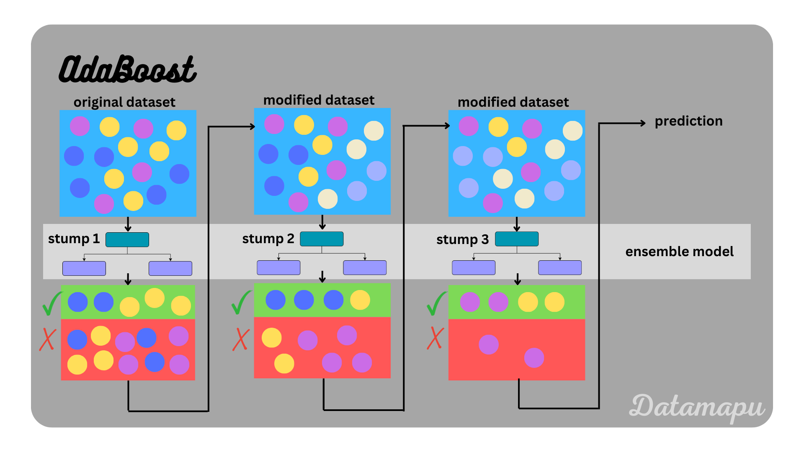
Ada Boosting-
Create a model using the original dataset.
It takes only the decision stump(onr eeot node and two leaf nodes)
Identify the wrong predictions made by the model.
Increase the weights of misclassified points(larger weight for incorrect predictions).
Train a new model using the modified dataset, with more focus on misclassified points.
Repeat the process until a final strong model is created by combining all the weak models.

Slide 3
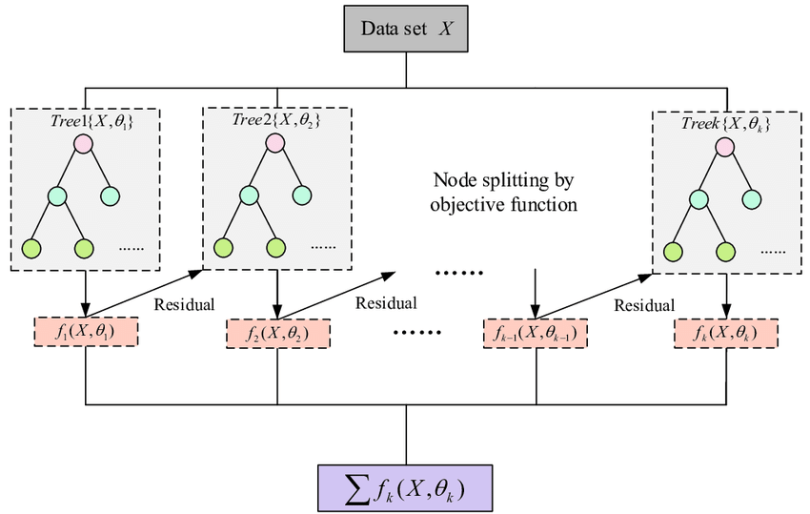
XG Boosting(Extreme Gradient Boosting)
XG Boost uses decision trees as its base learners combining them sequentially to improve the model’s performance.

Slide 4
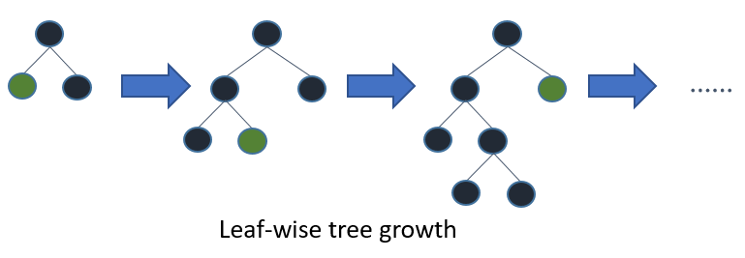
LightGBM Boosting
Light Gradient Boosting Machine
This Algorithm grows leaf wise
It uses histogram-based algorithms

